Slide 1
Personal Brand Image

Slide 2
Objectives & Flow
Objectives:
Grounding on what a Personal Brand Image is
Clarity on how to define and build your Personal Brand Image
Flow
What is a Brand and Why is it Important?
Define Your Personal Brand Image
Build Your Personal Brand Image
Create an Action Plan

Slide 3
What is a Brand?
Notes:
What is the first thing you think of when you see the following?
Good Performance (Price of Entry)
Defined target consumer
Clear what the product stands for or does (equity)
Meets a Need/Desire
Communicate/Demonstrate Reason To Believe
Good Marketing Strategy & Execution
Provides good value
Inspirational/Memorable
Availability/Accessibility
Consistency (Quality, Performance, etc.)
Grows with Consumers and Competition
Positive Differentiation from Competition
Positive or Net Zero Impact (Environment, Community, Health, etc.)

Slide 4
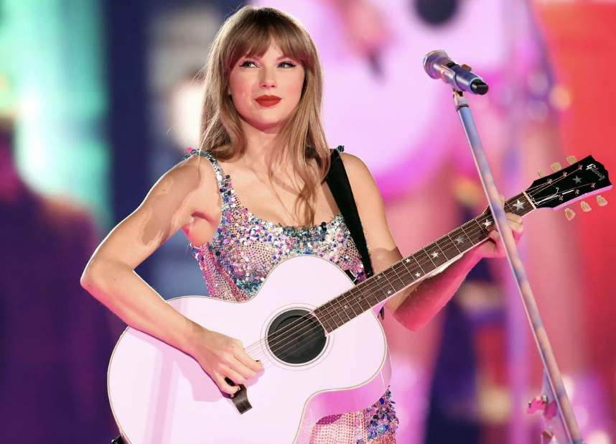
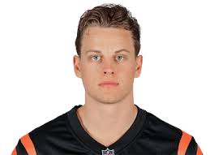
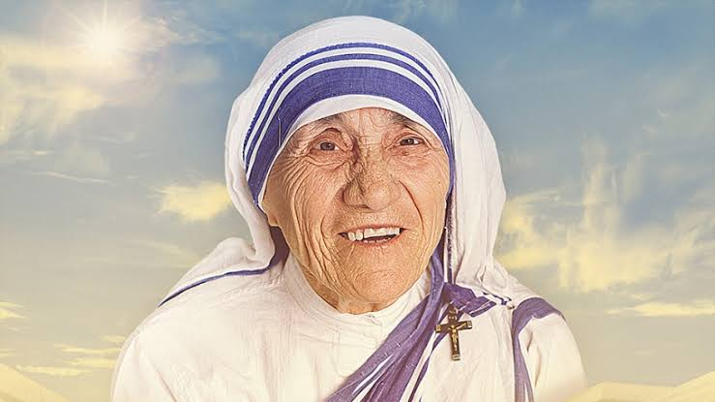
What About Personal Brand?
Notes:
What is the first thing you think of when you see the following?

Slide 5
Your Personal Brand Image
It's YOUR story – who you are and what you stand for
How you differentiate yourself
Also – how others perceive you

Slide 6
Why It's Important
Is with you throughout your life and career
It affects the first impression that people form of you
It affects how people relate to you and how you can expand your impact
Notes:
Challenges:
It is the least understood
Many Supervisors are not well equipped to coach on Image
Direct Reports have challenges with Image

Slide 7
Today
How to Build your Personal Brand Image
Define your Personal Brand Image
Make an Impact
Expand your Reach

Slide 8
1. Define Your Personal Brand Image
1. Define your Personal Brand Image
How can you uniquely help the world?
2. Make an Impact
How you help the world?
3. Expand Your Reach
Who else can you impact?

Slide 9
Define Your Personal Brand Image
Answer the following questions
What makes you Unique?
What do you Value?
How do you Show Up?
Notes:
being recognized for your unique self and skills, and increasing your visibility, access to opportunities, and growth

Slide 10
What Makes You Unique?
Your differences are your superpowers
What is your mix of background, culture, gender, class, ethnicity, etc.?
What is your area of expertise?
What's an example of how you have used your background, skills, experience to help others?

Slide 11
What do You Value?
What are some moments when you were happiest? Why?
What are some moments when you were most proud? Why?
What are some moments when you were most fulfilled? Why?
What are words that you used to describe the moments?
Examples: Honesty, enthusiasm, hard work, confidence, perseverance, beauty, family, respect, power, service, achievement, security, generosity, faith, etc.
Notes:
https://ssc.utah.edu/_resources/documents/tools_for_success_page_documents/defining_your_values_clean_ssc_logo_uppercase.pdf
Step 1: Identify the times when you were happiest Find examples from your school, work, and/or personal life. This will ensure some balance in your answers. • What were you doing? • Were you with other people? Who? • What other factors contributed to your happiness? Step 2: Identify the times when you were most proud Use examples from your school, work, and/or personal life. • Why were you proud? • Did other people share your pride? Who? • What other factors contributed to your feelings of pride? Step 3: Identify the times when you were most fulfilled and satisfied Again, use school, work, and/or personal examples. • What need or desire was fulfilled? • How and why did the experience give your life meaning? • What other factors contributed to your feelings of fulfillment? Step 4: Determine your top values, based on your experiences of happiness, pride, and fulfillment Why is each experience truly important and memorable? Use the following list of common personal values to help you get started—and aim for about 10 top values. (As you work through, you may find that some of these naturally combine. For instance, if you value philanthropy, community, and generosity, you might say that service to others is one of your top values.)
Step 5: Prioritize your top values This step is probably the most difficult, because you'll have to look deep inside yourself. It's also the most important step, because, when making a decision, you'll have to choose between solutions that may satisfy different values. This is when you must know which value is more important to you. • Write down your top values, not in any particular order. • Look at the first two values and ask yourself, “If I could satisfy only one of these, which would I choose?” It might help to visualize a situation in which you would have to make that choice. For example, if you compare the values of service and stability, imagine that you must decide whether to sell your house and move to another country to do valuable foreign aid work, or keep your house and volunteer to do charity work closer to home. • Keep working through the list, by comparing each value with each other value, until your list is in the correct order. Tip: If you have a tough time doing this, consider using Paired Comparison Analysis (http://www.mindtools.com/pages/article/newTED_02.htm) to help you. With this method, you decide which of two options is most important, and then assign a score to show how much more important it is. Since it's so important to identify and prioritize your values, investing your time in this step is definitely worth it. Step 6: Reaffirm your values Check your top-priority values, and make sure they fit with your life and your vision for yourself. • Do these values make you feel good about yourself? • Are you proud of your top three values? • Would you be comfortable and proud to tell your values to people you respect and admire? • Do these values represent things you would support, even if your choice isn't popular, and it puts you in the minority? When you consider your values in decision making, you can be sure to keep your sense of integrity and what you know is right, and approach decisions with confidence and clarity. You'll also know that what you're doing is best for your current and future happiness and satisfaction. Making value-based choices may not always be easy. However, making a choice that you know is right is a lot less difficult in the long run

Slide 12
How Do You Show Up?
What's your attitude?
How do you behave/act?
How do you present yourself?
Do your actions reflect your values? How?
How do you communicate and engage others?
How do you dress and look?

Slide 13
2. Make an Impact
1. Define your Personal Brand Image
How can you uniquely help the world?
2. Make an Impact
How you help the world?
3. Expand Your Reach
Who else can you impact?

Slide 14
Impact
How have you helped the world?
What type of impact is important to deliver?
What’s your expertise?
What type of situations do you work well in?
Who is involved in delivering the impact?
Notes:
How have you helped the world?
What type of impact is important to deliver? What’s your expertise?
School: Grades, leadership roles, teams, certifications, service activities
Business: Increase in sales, leads, growth, efficiency, morale, decrease in cost, time, errors
What type of situations do you work well in?
School: Groups, underdog teams, elite teams, highly-technical organizations, etc.
Business: Turnaround, start-up, big business, small business, etc., complex, highly regulated, consumer, business focused, etc.
Who is involved in delivering the impact?
School: individuals, teams, city, state, country, international, etc.
Work: Individuals, teams, divisions, functions, levels, leaders, etc.

Slide 15
3. Expand Your Reach
1. Define your Personal Brand Image
How can you uniquely help the world?
2. Make an Impact
How you help the world?
3. Expand Your Reach
How can you make a bigger impact?

Slide 16
Expand
How can you make a bigger Impact?
Who is in your network now?
How strong are your connections?
Who else would you like to have in your network?
How could you communicate your Impact within your network?
How could you build your network to make a bigger Impact?
Notes:
Mentor inside the company
Identify a person in the company who you naturally connect with
Ask him/her for a meeting to learn more about background, role and what’s important
At the end – ask if you can meet again
It will take time!
Do you have a mentor outside the company?
What type of person would you like to get to know?
How can you make a bigger Impact?
Who is in your network now? How strong are your connections? Who else would you like to have in your network? Create a specific list
Leaders, mentors, peers, team members, etc.
How could you communicate your Impact within your network?
School: Project summaries, recaps, use format of college applications?
Business: What type of “summaries” can you share that describe your performance?
How could you build your network of connections to make a bigger Impact?
Leaders: Could you set consistent meetings with leaders? How could you interact (naturally) with more senior leaders? What levels? What situations?
Mentors: Could you ask someone to be a mentor? Could you ask a few in your network of supporters to talk through your development and your career? (Parents’ friends?)
Peers: What informal information networks could you tap into (not gossip)?

Slide 17
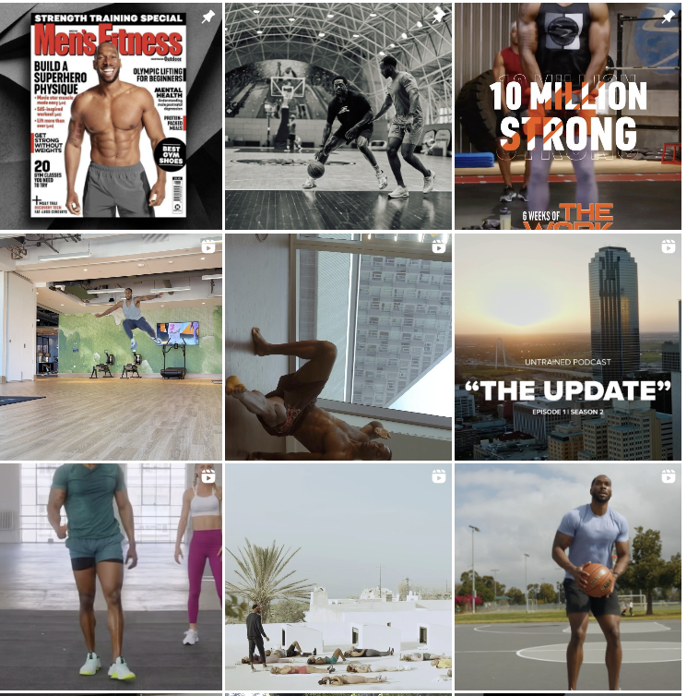
Personal Brand Image - Amoila Cesar
What’s his Style?
What makes Amoila Unique?
From humble beginnings to the top of the fitness world
What does he Value?
True fitness comes from both pushing your muscles to new limits as well as nurturing your mind
How does he Show Up?
Amoila is described as
How does he Impact the world?
Transformed the physiques of A-list stars as well as professional athletes playing in the NBA - helping them achieve feats of power, speed and endurance that fuel legendary actions.
How does he Expand his Reach?
PR, Social channels
Supplements + apparel
Notes:
Grew up in West Palm Beach, raised by a single mother with 7 siblings. Things were rough at times, and as the middle child
Discovered his passion for fitness at 13
Bachelor’s Degree - Exercise Science and Radio Television with a Minor in Psychology.
Moved to Los Angeles, CA. first job in the fitness was at LA Fitness
Joined Beach Body, becoming the eighth Beach Body Super Trainer.

Slide 18
Draft Your Image & Plan to Build it
Draft a Plan to Build your Personal Brand Image
Define your Personal Brand Image
What makes you unique?
What do you value?
How do you show up?
Explore how you positively Impact the world
Build stronger connections and Expand your reach

Slide 19
Thank You!

